Slide 1
Mastering pointers
CS 3335, Fall 2017
Dr. Zhiguang Xu

Slide 2
subjects
Pointers and memory addressing
Pointers and arrays
Pointers and functions
Passing pointers as parameters
Function pointers (later…)
Pointers and strings
Pointers and structures (later…)
Formatted I/O with printf() and scanf()

Slide 3
Pointers and memory addressing
A pointer (variable) stores the address of a piece of data in memory
To avoid copies
To share data
Pointer declaration, addressing, dereferencing, and more… (see pointers.c)
double d=10.2, f=2.8, *p; // p is a pointer to double
p = &d; //Addressing: gets address of a variable
printf(“d=%lf\n”, *p); //Dereferencing: reads the contents at an address pointed by a pointer
printf(“p=%p\n”, p); // Prints value of p (i.e. address of d)in Hex
f = *&d; // * and & are right associative operators with the same order of precedence, so this is the same as f = d;
p
d = 10.2

Slide 4
Pointers and memory addressing
Pointers generally occupy one word (4 bytes on 32-bit system; 8 bytes on 64-bit system) but can not be assumed. (Still see pointers.c)
We should not assume that a pointer points anywhere useful until we explicitly set it.
One pointer can be assigned to another only when
They both have the same type, or
When one of them is of generic type void *

Slide 5

Common mistakes, be careful!
Nothing prevents a pointer from pointing to an invalid address. Common mistakes are:
Cast an arbitrary integer to pointers
Adjust pointers beyond the boundary of an array
De-allocate storage that other points still reference

Slide 6
Pass the value v.s. pass the pointer to a function
To better understand pointers, you’ll need to dig into the memory of your computer. See the picture on page 80.
Code section
Constants
Globals
Heap
Stack
southeast.c on page 44 - 51

Slide 7
Pointers and arrays – some basics (1)
int a[3] = {-1, 2, 0};// pointerandarray.c int b[]={20,1};
An array variable is in effect a “pointer constant” which happens to hold the address of the first element in the array).
So a and b’s type above is int * const, and you can not do a = b;
The dirty little secret is that when the program is compiled, all array variables won’t even exist in the final executable because they are replaced with addresses of the arrays they reference to!
Therefore, int a[] is illegal (unless it is a function argument which we will discuss later) since an explicit size or an initializer is needed.
sizeof(a) returns the number of bytes in a
You can change the elements in the array through array variables though. Like a[1]=23;

Slide 8
Pointers and arrays – some basics (2)
[] is left associative and has higher order than &
int a[3] = {-1, 2, 0}; int *c =a; // or c=&a[0]; c = b;
The regular pointer c above is not a constant like a and b anymore. It can be changed to point to somewhere else.
sizeof(c) returns 4 or 8 – the number of bytes to store a pointer, which is system-dependent.
Pointer decay: when you assign an array to a pointer, the pointer doesn’t know anything about the size of the array, so a little information is lost!
It is up to the programmer to keep track of the size.
This happens when passing an array to a function (later…)

Slide 9
Order and associativity of operators
The chart below contains order/level/precedence and associativity of pointer-related operators
It will be of great help when you interpret complex expressions
Operators | Order | Associativity
(), [] , ., -> | 2 | Left to right
*, & | 3 | Right to left
Note: The . and -> operators will be discussed later.

Slide 10
Pointers and arrays – some basics (3)
*(c+1)=-9; //or equivalently c[1]=-9;
Address arithmetic – “If c is a pointer to a type, then c+1 yields the correct machine address for storing or accessing the next variable of that type.”
Now you know why pointers must have types.
The compiler relies on such types to adjust the pointer arithmetic.
More later…

Slide 11
Pass an array to a function
void fortune_cookie(char msg[]){
// This is equivalent to
// void fortune_cookie(char *msg) {
printf(“Message: %s\n”, msg);
printf(“msg occupies %i bytes\n”, sizeof(msg));
}
char quote[] = “Cookies make you fat”;
fortune_cookie(quote);
Passing arrays are passing pointers, where “pointer decay” occurs.
The second printf() prints 4 or 8 instead of 21.
Actually, the latter format is more preferred than the former, because the former is kind of misleading.

Slide 12
Useful hints (1)
Every variable/data, pointer included, has its
Type
Size
Value
Address
E.g. int a[3] = {-1, 2, 0}; int *c =a;
Variable | Type | Size | Value | Address
a[0] | int | sizeof(int), system dependent | -1 | 0x foo
a | array of int (or pointer constant) | # of bytes in array a i,e. sizeof(int) * 3 | address of a[0] | 0x bar
c | pointer to int | 4 or 8 bytes, system dependent | address of a[0] | 0x baz

Slide 13
Useful hints (2)
*p ➔ dereference p, which is a pointer to some type ➔ data pointed by p
&x ➔ address of x ➔ pointer to type of x
b[i] ➔ *(b+i) ➔ *(from where b currently is plus i * size of single data in bytes that b points to) ➔ deference the data at the new location

Slide 14
Two-dimensional arrays
 | Col 0 | Col 1 | Col 2 | Col 3 | Col 4
Row 0 | a[0][0] | a[0][1] | a[0][2] | a[0][3] | a[0][4]
Row 1 | a[1][0] | a[1][1] | a[1][2] | a[1][3] | a[1][4]
Row 2 | a[2][0] | a[2][1] | a[2][2] | a[2][3] | a[2][4]
int a[3][5];
Q: sizeof(a),sizeof(a[0]),sizeof(*a), given sizeof(int) is 4? A: 60, 20, 20
Q: expressions equivalent to a[i][j]? A: *(a[i]+j), (*(a+i))[j], *((*(a+i))+j), *(&a[0][0]+5*i+j), …
Passing two/multi-dimensional array to a function
Formal parameter: all sizes except the first must be specified, so that the compiler can do correct pointer arithmetic inside the function.
See 2darrays.c

Slide 15
Quick exercise
Difference between int *x[2] and int (*x)[2] ?
Work your way through starting near the variable name "x" and finishing up with type, keeping in mind Operator Precedence. Meaning, anything in ()'s and []s before *'s.
x[] -- x is an array *x[] -- x is an array of pointers int *x[] -- x is an array of pointers to ints
(*x) -- x is a pointer (*x) [] -- x is a pointer to an array int (*x)[] -- x is a pointer to an array of type int

Slide 16
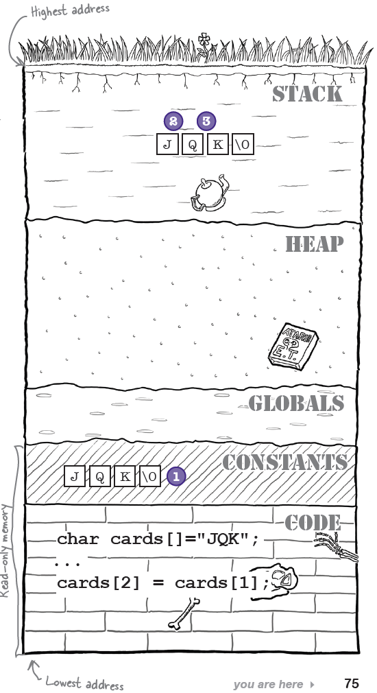
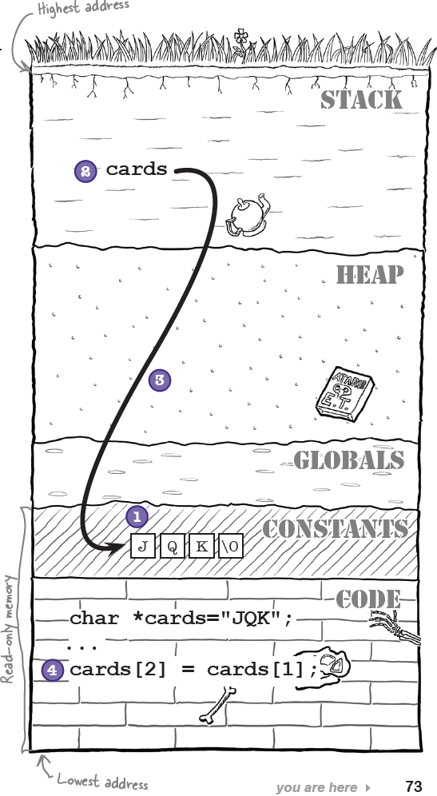
A closer look at strings
char *cards = “JQK”; //A string literal
cards[2] = cards[1]; // Wrong!
char cards[] = “JQK”; //Make a copy
cards[2] = cards[1]; // fine
* Assuming the code above is inside a function.

Slide 17
A closer look at strings
Make sure you understand the difference between
char cards[] = “JQK”; // size = 4 with ‘\0’
char cards[] = {‘J’, ‘Q’, ‘K’};// size = 3
The compiler will help you if you explicitly make the contents of the storage that your pointer points to constant: const char *cards = “JQK”;
// Compiler error on next line: assignment of read-only location
cards[2] = cards[1];
Make you understand the difference between
const char *cards = “JQK”;
char * const cards = “JQK”;
So, cards[] or *cards? See “Geek bits” on page 74.

Slide 18
Formatted output
int printf(const char *format, …)
format: a string that contains text with embedded conversion specs to be written to stdout
Conversion specs
Returns # of characters printed
http://www.cplusplus.com/reference/clibrary/cstdio/printf/
sprintf() and fprintf()
% | [flags] | [field width] | [.precision] | [length modifier] | specifier
 | +, -,’ ‘, #, 0 | Min width of the converted argument | Min number of digits | h, l, L | d, i, o, u, x, X: integers
 |  |  | Number of digits after the decimal point |  | e, E, f: floating point
 |  |  | Max number of significant digits |  | g: shorter of %e or %f G: shorter of %E or %f
 |  |  | Max number of characters |  | S: string

Slide 19
Formatted input
int scanf(const char *format, …)
format: a string that contains
white spaces (including whitespace, newline, and tab): skip any number of whitespaces in the input stream
ordinary (non-whitespace) chars: must match
Conversion specs
Skips white spaces unless reading a character with %c
Returns number of successful conversions
http://www.cplusplus.com/reference/clibrary/cstdio/scanf/
sscanf() and fscanf()
% | [*] | [width] | [modifiers] | type
 | Results of the conversions are not assigned to any variables | Max number of chars to read | h, l, L | c, d, e,E, f, g, G o, s, u x, X

Slide 20
Formatted input
An example:
char c, *cntrl_string, save[7], store[15];
int a, cnt;
cntrl_string = “%d , %*s %% %c %[abc] %*s %5s %s”;
cnt = scanf(cntrl_string, &a, &c, save, store, &store[5];
With the following charcters in stdin:
23 , ignore_this % C abacus read_in_this**
Results:
a = 23, c = ‘C’,
“abac\0” in save[0] through save[4], “read_\0” in store[0] through store[5],
and “in_this**\0” in store[5] through store[14] (I,e, ‘\0’ in store[5] is overwritten by ‘i’)
A string that contains any of these three chars

Slide 21
Be careful with scanf()
Good
char f_n[20];
char l_n[20];
printf(“Enter first and last name: “);
scanf(“%19s %19s”,f_n, l_n);
// First name and last name can not contain whitespaces though.
Buffer overflow
char food[5];
printf(“Enter favorite food: “);
scanf”%s”,food);
// Trouble (overflow) if more than 4 characters are received
Use fgets() as alternative
char food[5];
printf(“Enter favorite food: “);
fgets(food, sizeof(food), stdin);
// Only receive up to 4 chars, “\n” included
// To remove “\n”:
// if (strstr(food, “\n”))
// food[strlen(food) -1]=‘\0’;
scanf() vs. fgets(): page 68.

